Slide 1

Module 4: Polymorphism

Slide 2
POLYMORPHISM
In Java, polymorphism refers to the fact that you can have multiple methods with the same name in the same class
There are two kinds of polymorphism:
Overloading
Overriding

Slide 3
Overloading
With method overloading, multiple methods can have the same name with different parameters

Slide 4
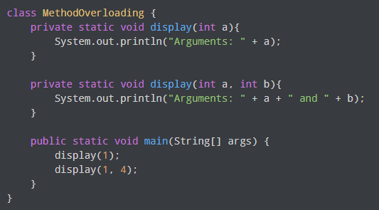

1. Overloading by changing the number of parameters
OUTPUT

Slide 5
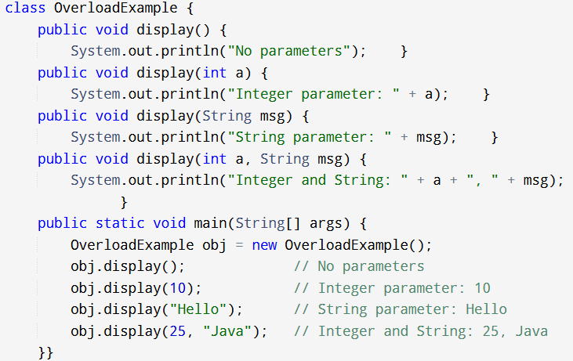

Slide 6
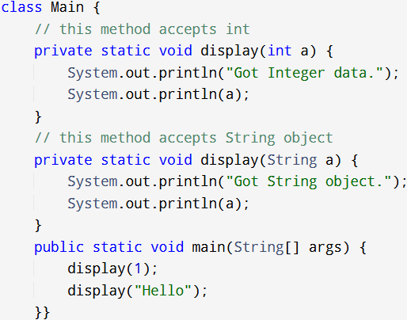
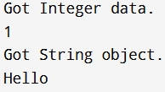
2. Method Overloading by changing the data type of parameters
OUTPUT

Slide 7
Overriding
If the subclass (child class) has the same method as declared in the parent class, it is known as method overriding in Java.
The method of the subclass class overrides the method of the superclass.

Slide 8
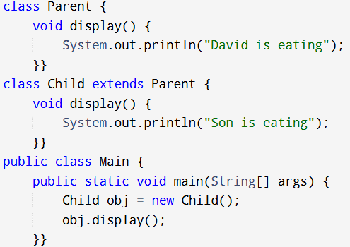
Example
OUTPUT

Slide 9
Rules for Java Method Overriding
The method must have the same name as in the parent class method.
The method must have the same parameter as in the parent class method.
The same number and types of parameters
Parameter names don’t matter, just their types
There must be an inheritance relationship.
The return type must be the same

Slide 10
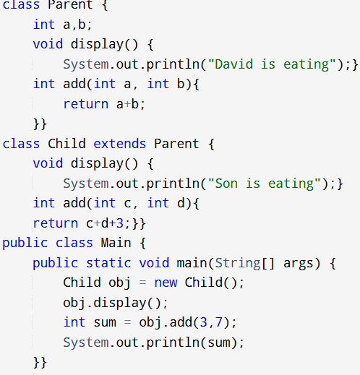

EXAMPLE
OUTPUT

Slide 11
Abstract Class and Abstract methods
Abstract class: is a restricted class that cannot be used to create objects (to access it, it must be inherited from another class).
Abstract method: can only be used in an abstract class, and it does not have a body. The body is provided by the subclass (inherited from).

Slide 12
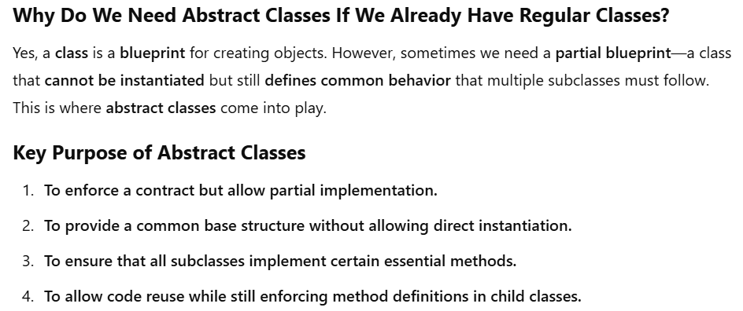

Slide 13
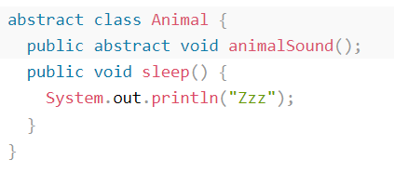
An abstract class can have both abstract and regular methods.
It is not possible to create an object of the Animal class.

Slide 14
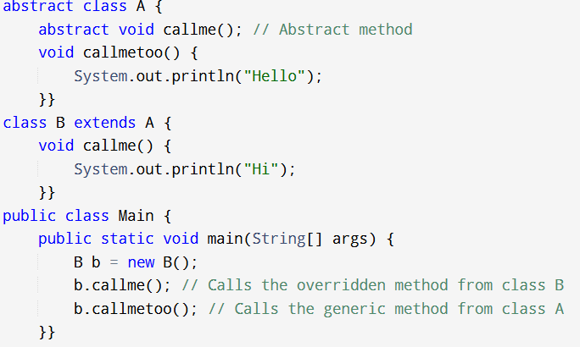

EXAMPLE 1:
OUTPUT

Slide 15
Super Keyword
Whenever a subclass needs to refer to its immediate superclass, it can do so by use of the keyword super.

Slide 16
Final Keyword
The final keyword is a non-access modifier used for classes,
attributes and methods, which makes them non-changeable
(impossible to inherit or override).
Once any entity (variable, method or class) is declared final, it can
be assigned only once. That is,
the final variable cannot be reinitialized with another value
the final method cannot be overridden
the final class cannot be extended

Slide 17
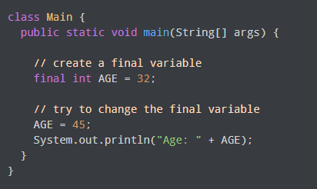
1. final variable cannot be reinitialized with another value

Slide 18
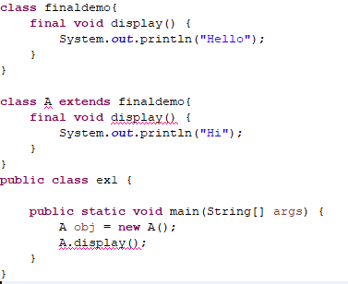
2. final method cannot be overridden

Slide 19
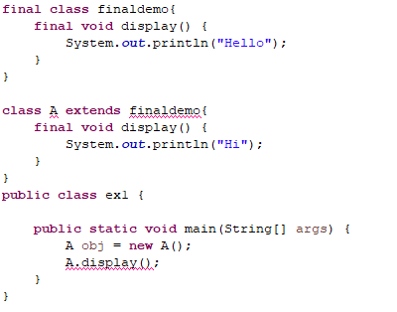
3. final class cannot be extended

